Slide 1
IT Project Management
Project Quality Management

Slide 2
Learning Outcomes
At the end of the lesson student should be able to:
Define what is software quality,
explain why qualities important for software project,
quality assurance techniques,
standards,
quality assurance process.

Slide 3
Quality of Information Technology Projects
Project quality management includes the processes required to ensure that the project will satisfy the needs for which it was undertaken.
Quality is very important in many IT projects

Slide 4
What Is Quality?
The International Organization for Standardization (ISO) defines quality as “the degree to which a set of inherent characteristics fulfils requirements”
(ISO9000:2000).Other experts define quality based on
conformance to requirements: meeting written specifications
fitness for use: ensuring a product can be used as it was intended

Slide 5
Project Quality Management Processes
Project quality management ensures that the project will satisfy the needs for which it was undertaken.
Main processes include:
Quality planning
Quality assurance
Quality control

Slide 6
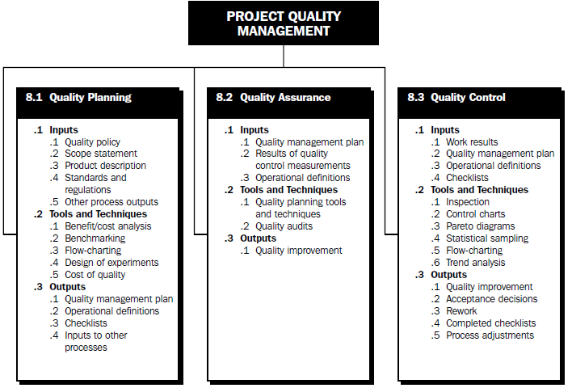

Slide 7
Quality Planning
Identifying which quality standards are relevant to the project and how to satisfy them
It is important to design in quality and communicate important factors that directly contribute to meeting the customer’s requirements
Design of experiments helps identify which variables have the most influence on the overall outcome of a process

Slide 8
Quality Assurance
Quality assurance includes all the activities related to satisfying the relevant quality standards for a project
Another goal of quality assurance is continuous quality improvement
Benchmarking generates ideas for quality improvements by comparing specific project practices or product characteristics to those of other projects or products within or outside the performing organization.
A quality audit is a structured review of specific quality management activities that help identify lessons learned that could improve performance on current or future projects.

Slide 9
Quality Control
Monitoring specific project results to ensure that they comply with the relevant quality standards while identifying ways to improve overall quality
The main outputs of quality control are
acceptance decisions
rework
process adjustments
Some tools and techniques include
Pareto analysis
statistical sampling
Six Sigma
quality control charts

Slide 10
Pareto Analysis
Pareto analysis involves identifying the vital few contributors that account for the most quality problems in a system
Pareto diagrams are histograms that help identify and prioritize problem areas

Slide 11
Statistical Sampling
Statistical sampling involves choosing part of a population of interest for inspection
The size of a sample depends on how representative you want the sample to be
Sample size formula:
Sample size = .25 X (certainty Factor/acceptable error)²

Slide 12
Commonly Used Certainty Factors
95% certainty: Sample size = 0.25 X (1.960/.05) ² = 384
90% certainty: Sample size = 0.25 X (1.645/.10)² = 68
80% certainty: Sample size = 0.25 X (1.281/.20)² = 10

Slide 13
Testing
Testing should be done during almost every phase of the IT product development life cycle.

Slide 14
Types of Tests
Unit testing tests each individual component (often a program) to ensure it is as defect-free as possible.
Integration testing occurs between unit and system testing to test functionally grouped Components.
System testing tests the entire system as one entity.
User acceptance testing is an independent test performed by end users prior to accepting the delivered system.

Slide 15
Six Sigma Defined
Six Sigma is “a comprehensive and flexible system for achieving, sustaining and maximizing business success. Six Sigma is uniquely driven by close understanding of customer needs, disciplined use of facts, data, and statistical analysis, and diligent attention to managing, improving, and reinventing business processes.”*
*Pande, Peter S., Robert P. Neuman, and Roland R. Cavanagh, The
Six Sigma Way. New York: McGraw-Hill, 2000, p. xi

Slide 16
DMAIC
Six Sigma projects normally follow a five-phase improvement process called DMAIC
Define: Define the problem/opportunity, process, and customer requirements
Measure: Define measures, collect, compile, and display data
Analyze: Scrutinize process details to find improvement opportunities
Improve: Generate solutions and ideas for improving the problem
Control: Track and verify the stability of the improvements and the predictability of the solution

Slide 17
Quality Control Charts
A control chart is a graphic display of data that illustrates the results of a process over time. It helps prevent defects and allows you to determine whether a process is in control or out of control
The seven run rule states that if seven data points in a row are all below the mean, above, the mean, or increasing or decreasing, then the process needs to be examined for non-random problems

Slide 18
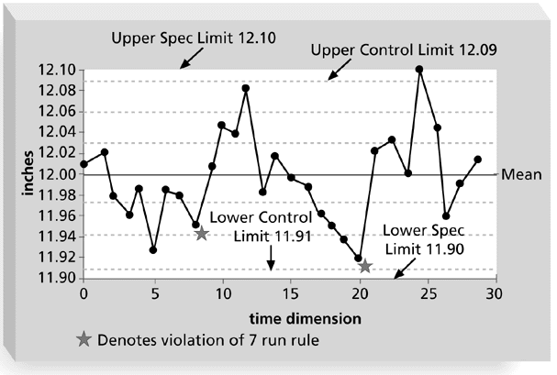
Sample Quality Control Chart

Slide 19
ISO Standards
ISO 9000 is a quality system standard that:
Is a three-part, continuous cycle of planning, controlling, and documenting quality in an organization.
Provides minimum requirements needed for an organization to meet its quality certification standards.
Helps organizations around the world reduce costs and improve customer satisfaction.
ISO 15504, sometimes known as SPICE (Software Process Improvement and Capability dEtermination), is a framework for the assessment of software processes.

Slide 20
Improving Information Technology Project Quality
Several suggestions for improving quality for IT projects include
Leadership that promotes quality
Understanding the cost of quality
Focusing on organizational influences and workplace factors that affect quality
Following maturity models to improve quality

Slide 21
Leadership
A large percentage of quality problems are associated with management, not technical issues.

Slide 22
The Cost of Quality
The cost of quality is the cost of conformance plus the cost of nonconformance.
Conformance means delivering products that meet requirements and fitness for use.
Cost of nonconformance means taking responsibility for failures or not meeting quality expectations.
*RTI International, “Software Bugs Cost U.S. Economy $59.6 Billion Annually, RTI Study Finds,” July 1, 2002.

Slide 23
Five Cost Categories Related to Quality
Prevention cost: Cost of planning and executing a project so it is error-free or within an acceptable error range.
Appraisal cost: Cost of evaluating processes and their outputs to ensure quality.
Internal failure cost: Cost incurred to correct an identified defect before the customer receives the product.
External failure cost: Cost that relates to all errors not detected and corrected before delivery to the customer.
Measurement and test equipment costs: Capital cost of equipment used to perform prevention and appraisal activities.

Slide 24
Organizational Influences, Workplace Factors, and Quality
Study by DeMarco and Lister showed that organizational issues had a much greater influence on programmer productivity than the technical environment or programming languages.
Programmer productivity varied by a factor of one to ten across organizations, but only by 21 percent within the same organization.
Study found no correlation between productivity and programming language, years of experience, or salary.
A dedicated workspace and a quiet work environment were key factors to improving programmer productivity.

Slide 25
Expectations and Cultural Differences in Quality
Project managers must understand and manage stakeholder expectations.
Expectations also vary by:
Organization’s culture
Geographic regions

Slide 26
Maturity Models
Maturity models are frameworks for helping organizations improve their processes and systems.
The Software Quality Function Deployment Model focuses on defining user requirements and planning software projects.
The Software Engineering Institute’s Capability Maturity Model is a five-level model laying out a generic path to process improvement for software development in organizations.

Slide 27
Maintenance
Maintenance plan
Predicts the maintenance requirements of the system,
Maintenance cost
effort required

